Slide 1
Internship Presentation
Sree Harshika

Slide 2
Guaranteed Quality Levels(GQL’s) Azure Support Center(ASC) Dashboard
Automation for AKS Assessment Service

Slide 3
What are GQL’s?
GQL’s are End To End Tests that Identify health of functional Aspects of the service.​
GQL’s are set of standards to make sure we are maintaining quality​.
GQL’s run daily to ensure all functional requirements of the service is worked as expected from customer’s perspective.

Slide 4

Managed Identity We created the resources ->CloudTest Account​ ->1ES Managed Image​ ->CloudTest Pool​ New Cloud Test Run.
Approach

Slide 5
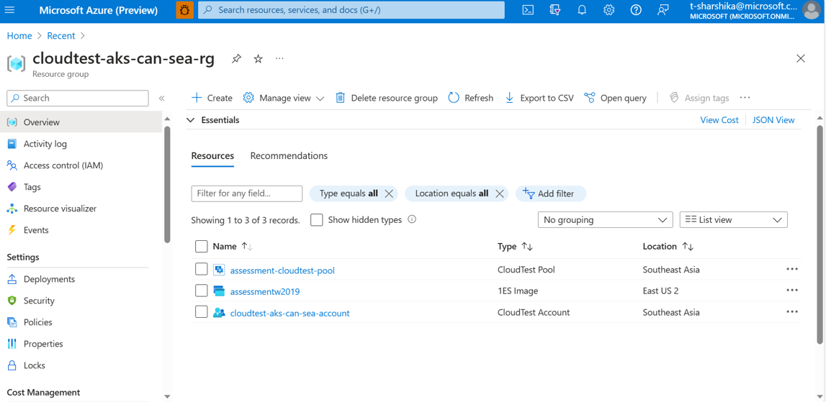
Section divider
Subtitle

Slide 6
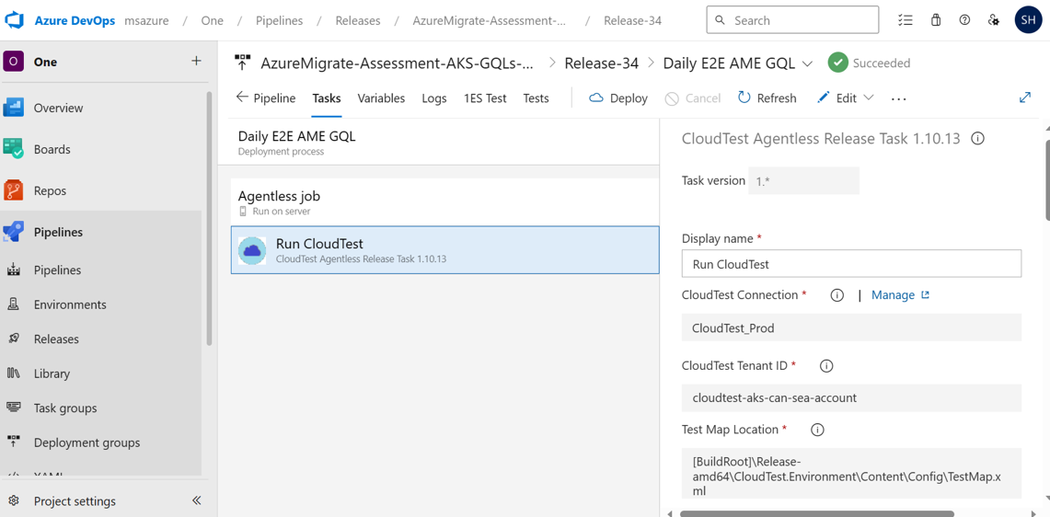

Slide 7
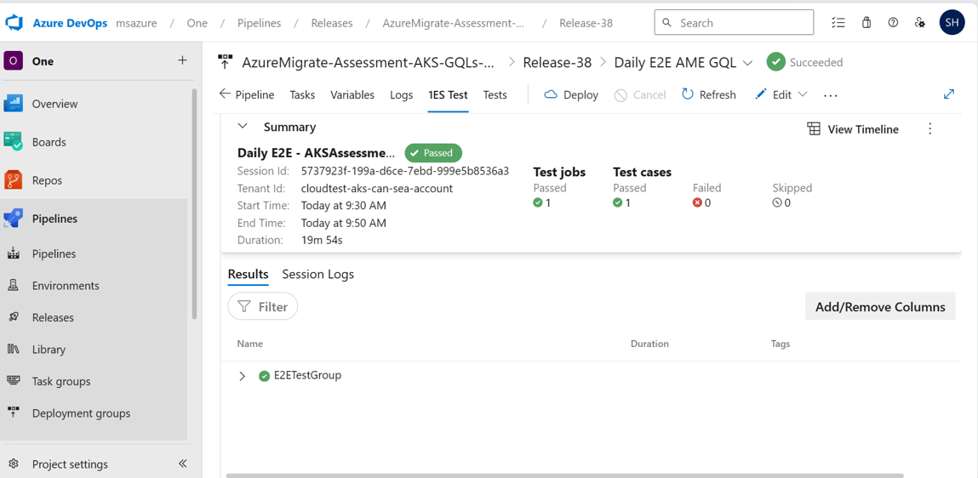
Output

Slide 8
Creating Assessment Getting Assessment details Getting Cost Details Getting Cluster Details Getting Summary of Assessment Getting details of Assessed WebApp Getting Report URI Deleting the Assessment
End To End Scenario

Slide 9
Create Assessment
Assessment
Input
PUT
Check Status
GET
AKS Assessment Service
Wait
NO
Is completed?
YES
Assessment Details

Slide 10
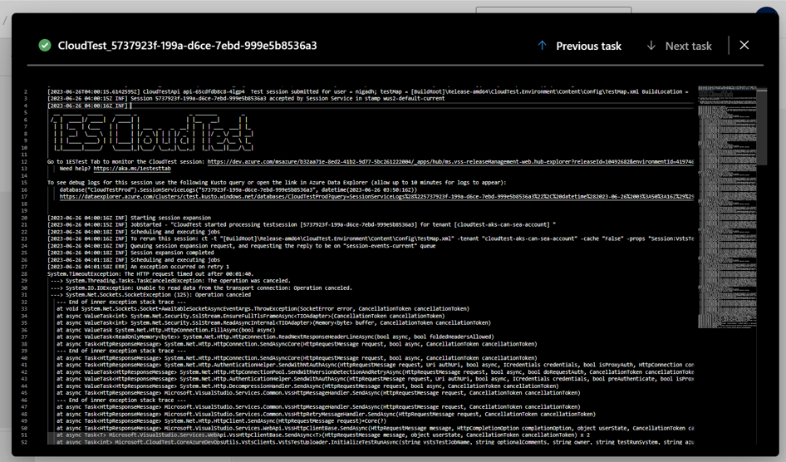

Slide 11
New Repo. Components are made configurable. Added required validations.
Design Decisions

Slide 12
Why Different Repo?
We ensure a clear separation between GQL tests and service code, resulting in improved code organization and maintainability.
Isolation between Service Code and Test Code ensures bug in Service Code is not introduced in Test Code and is caught by avoiding code sharing.
Builds take lesser time helping debug cycles.
Makes it easier for new team member to understand GQL Code.

Slide 13
Helps identify the bugs on daily basis This will help PLR (public launch readiness) sign-off of AKS assessment service.
IMPACT

Slide 14
ASC Dashboard for AKS Assessment Service

Slide 15
Enables support engineers to view service logs, thus helping them in diagnosing and debugging Azure customer issues.
What?

Slide 16
Execution Flow

Slide 17
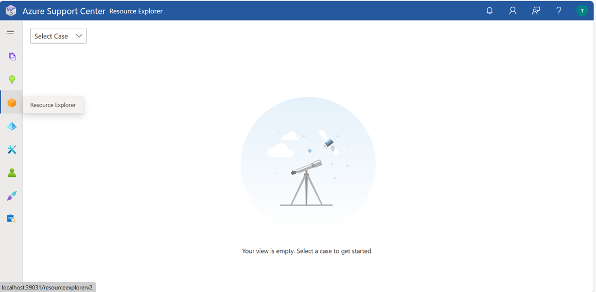

Slide 18
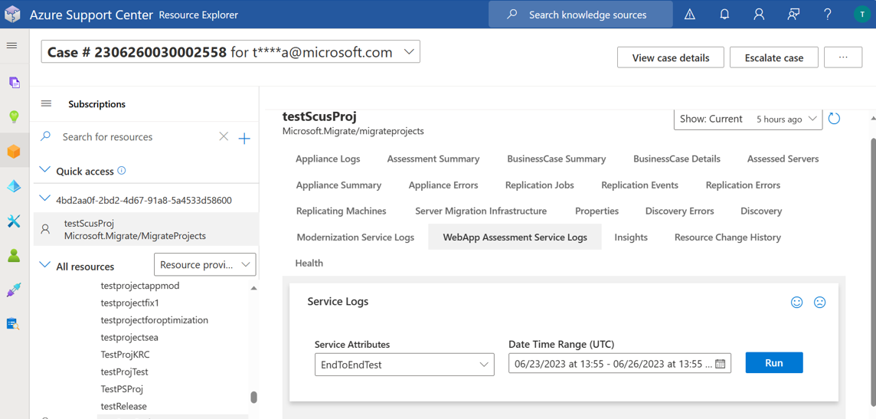




Slide 19
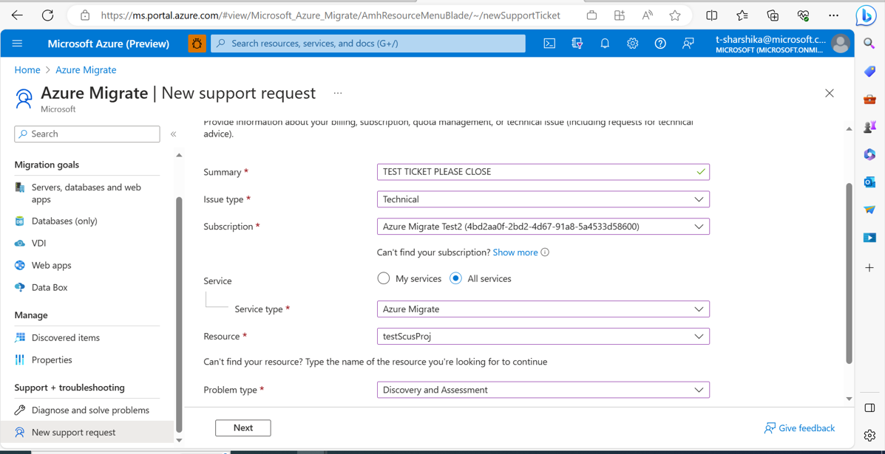
OUTCOMES:

Slide 20
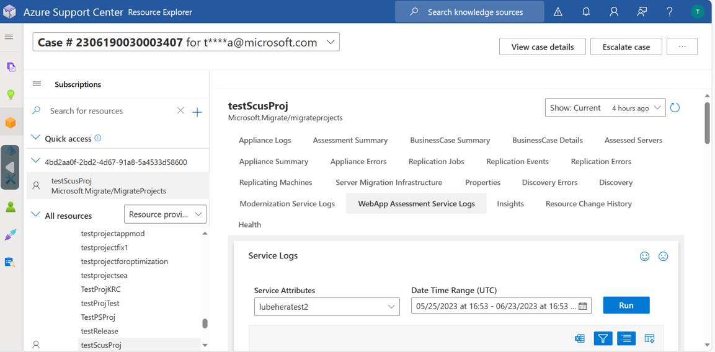



Slide 21
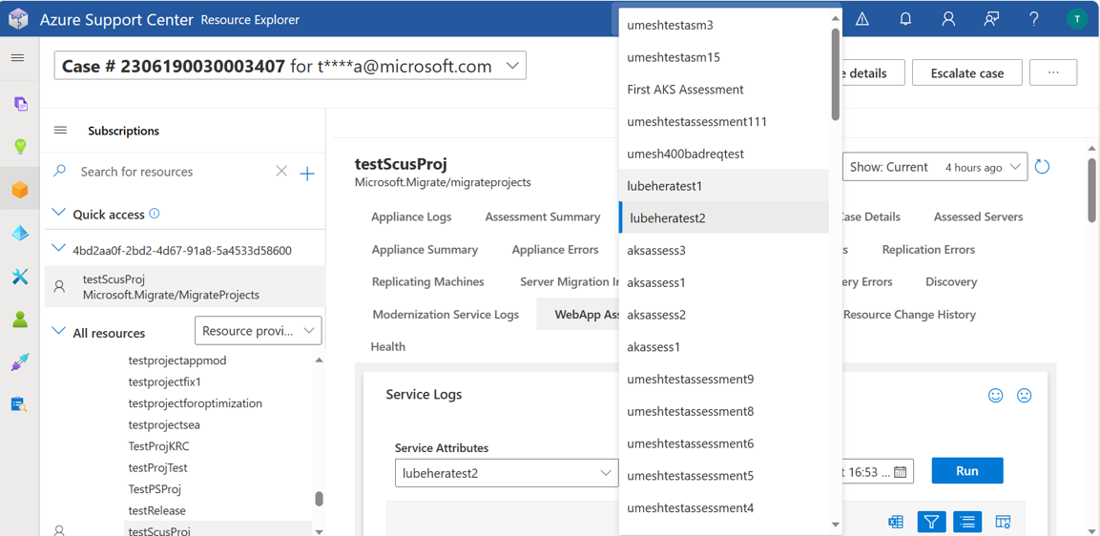

Slide 22
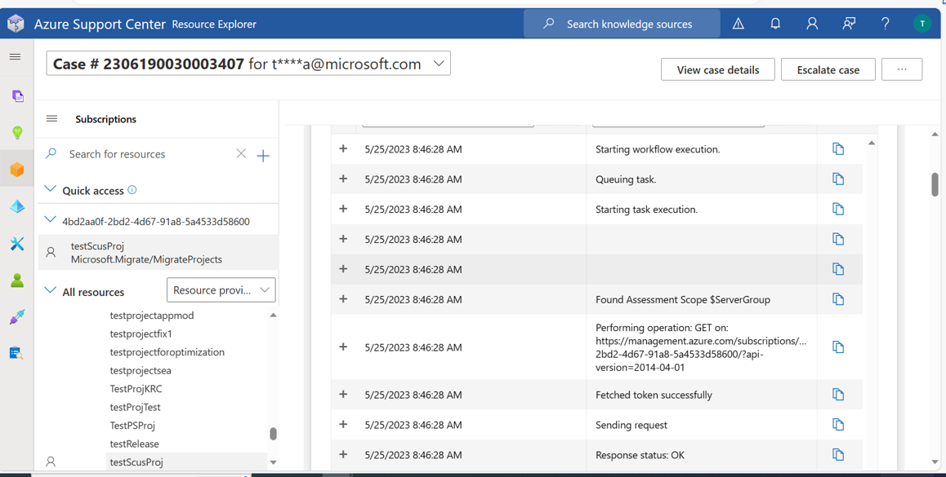

Slide 23

Impact

Slide 24
Questions?

Slide 25
Thank you

